Slide 1

Week 9: Hidden Markov Models Russell & Norvig, Chapter 15.
(Most of slides from Dan Klein, Pieter Abbeel)

Slide 2
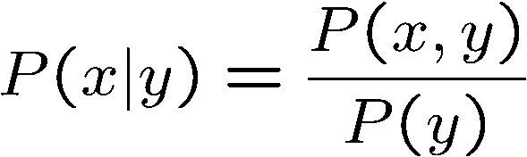

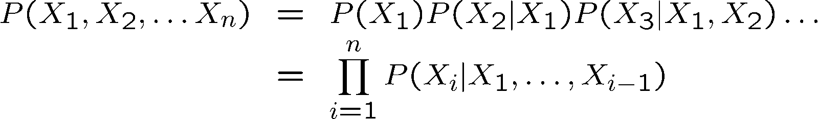

Probability Recap
Conditional probability
Product rule
Chain rule
X, Y independent if and only if:
X and Y are conditionally independent given Z if and only if:

Slide 3
Reasoning over Time or Space
Often, we want to reason about a sequence of observations where the state of the underlying system is changing
Speech recognition
Robot localization
User attention
Medical monitoring
Global climate
Need to introduce time into our models

Slide 4
Markov assumption
Markov assumption: The assumption that the current state depends on only a finite fixed number of previous states.
Markov chain: a sequence of random variables where the distribution of each variable follows the Markov assumption

Slide 5
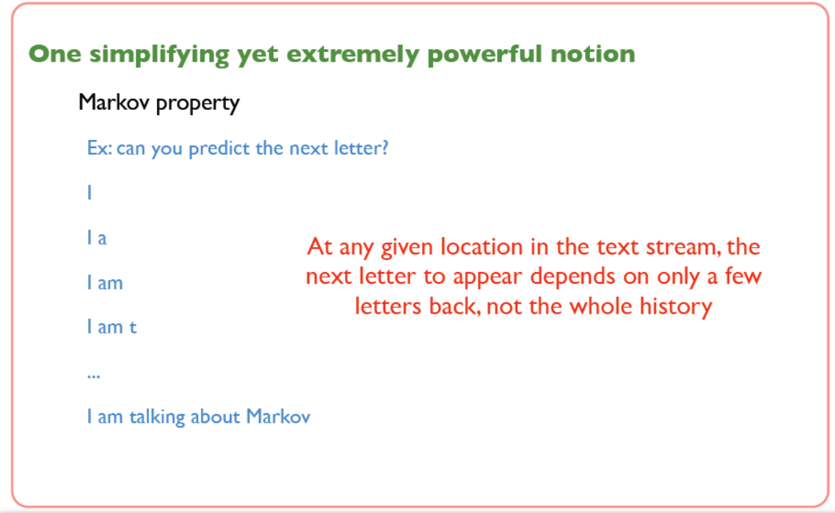
Markov assumption

Slide 6
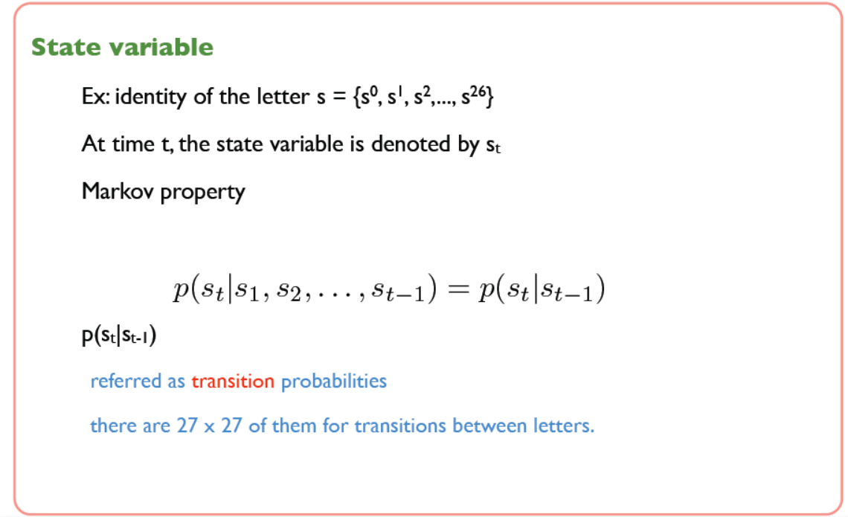
Markov assumption

Slide 7
Markov Models (aka Markov chain/process)
Value of X at a given time is called the state (usually discrete, finite)
The transition model P(X_{t} | X_{t-1}) specifies how the state evolves over time
Stationarity assumption: transition probabilities are the same at all times
Markov assumption: “future is independent of the past given the present”
X_{t+1} is independent of X₀,…, X_{t-1} given X_{t}
This is a first-order Markov model (a kth-order model allows dependencies on k earlier steps)
Joint distribution P(X₀,…, X_{T}) = P(X₀) ∏_{t} P(X_{t} | X_{t-1})
X₀
X₁
X₂
X₃
P(X₀)
P(X_{t} | X_{t-1})

Slide 8
Markov Models (aka Markov chain/process)
First-order Markov process: the current state depends only on the previous state and not on any earlier states.
P(X_{t} | X_{0:t-1}) =
P(X_{t} | X_{t-1})
Current t-1 state provides enough information to make the future conditionally independent of the past,
Second-order Markov process: The transition model for a second-order Markov process is the conditional distribution
P(X_{t} | X_{t-2} , X_{t-1})
Sensor Markov assumption (observation model)
P(E_{t} | X_{0:t}, E_{0:t-1}) =

Slide 9
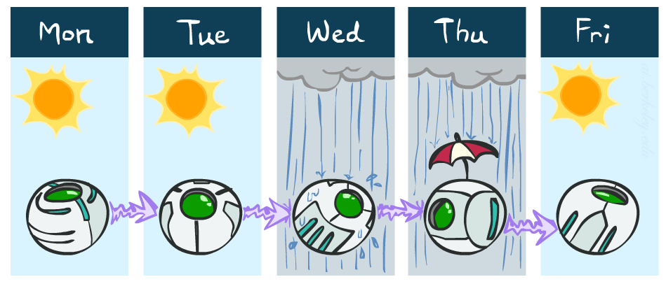
Example Markov Chain: Weather
States: X = {rain, sun}
Initial distribution: 1.0 sun
CPT P(X_{t} | X_{t-1}):
Two new ways of representing the same CPT
X_{t-1} | X_{t} | P(X_{t}|X_{t-1})
sun | sun | 0.9
sun | rain | 0.1
rain | sun | 0.3
rain | rain | 0.7
0.9
0.3
0.9
rain
sun
sun
sun
0.1
0.3
rain
rain
0.7
0.7
0.1

Slide 10
Example Markov Chain: Weather
0.9
Initial distribution: 1.0 sun
What is the probability distribution after one step?
0.3
rain
sun
0.7
0.1
Notes:
P(rain) = > P(rain | sun) P(sun) + P (rain|rain) P(rain)
0.1 * 1 + 0.7 * 0 = 0.1

Slide 11
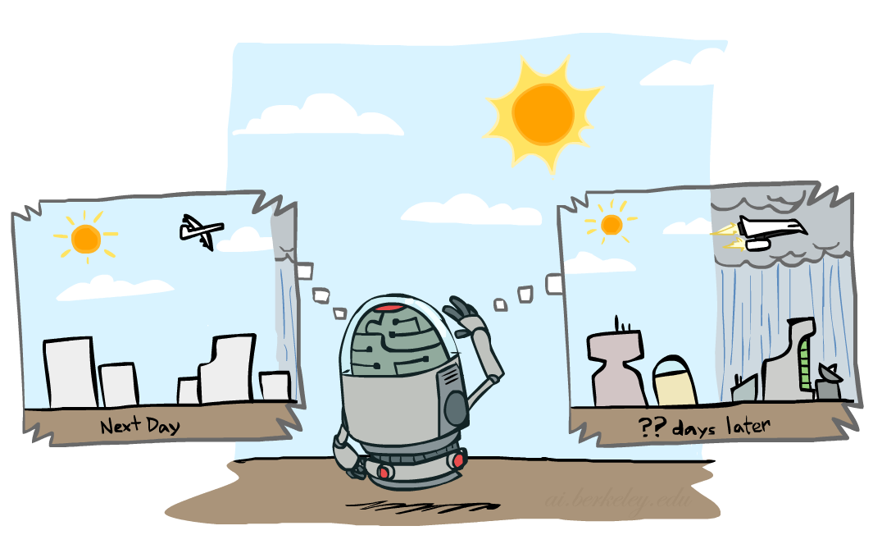

Mini-Forward Algorithm
Question: What’s P(X) on some day t?
X₁
X₂
X₃
X₄
Forward simulation

Slide 12
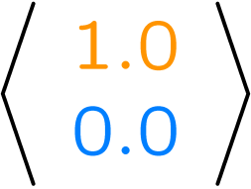
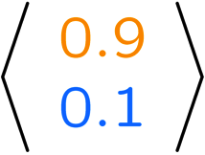
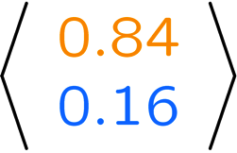
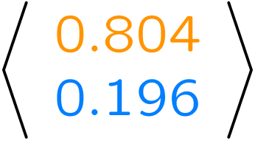
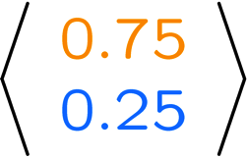
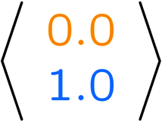
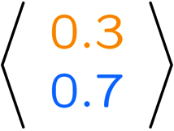
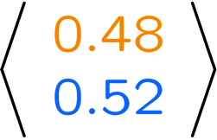
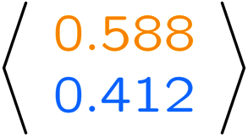
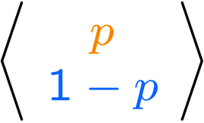
Example Run of Mini-Forward Algorithm
From initial observation of sun
From initial observation of rain
From yet another initial distribution P(X₁):
P(X₁)
P(X₂)
P(X₃)
P(X₄)
P(X∞)
P(X₁)
P(X₂)
P(X₃)
P(X₄)
P(X∞)
…
P(X₁)
P(X∞)
[Demo: L13D1,2,3]
Notes:
P(sun) = > P(sun | sun) P(sun) + P (sun | rain) P(rain)
0.9 * 0.9 + 0.3 * 0.1 = 0.84
P(rain) = > P(rain | sun) P(sun) + P (rain | rain) P(rain)
0.1 * 0.9 + 0.7 * 0.1 = 0.09 + 0.07 = 0.16

Slide 13
Forward algorithm (simple form)
What is the state at time t?
P(X_{t}) = ∑_{xt-1} P(X_{t},X_{t-1}=x_{t-1})
= ∑_{xt-1} P(X_{t-1}=x_{t-1}) P(X_{t}| X_{t-1}=x_{t-1})
Iterate this update starting at t=0
P(X₁) = P(X₁ )
P(X₂) = P(X₁ ) P(X₂ | X₁)
P (X₃ ) = P(X₂) P(X₃ | X₂)
P(X_{1,} X_{2,} X₃) = P(X₁ ) P(X₂ | X₁) P(X₃ | X₂)
Probability from previous iteration
Transition model

Slide 14
Hidden Markov Models
Markov chains not so useful for most agents
Need observations to update your beliefs
Hidden Markov models (HMMs)
Underlying Markov chain over states X
You observe outputs (effects) at each time step
An HMM is a temporal probabilistic model in which the state of the process is described by a single, discrete random variable
HMMs require the state to be a single, discrete variable, there is no corresponding restriction on the evidence variables.
X₁
X₂
X₃
X₄
X₅
E₁
E₂
E₃
E₄
E₅

Slide 15



Example: Weather HMM
Rain_{t-1}
Rain_{t}
Rain_{t+1}
Umbrella_{t-1}
Umbrella_{t}
Umbrella_{t+1}
Figure 2: Bayesian network structure and conditional distributions describing the umbrella world. The transition model is P(Raint | Raint−1) and the sensor model is P(Umbrellat | Raint).
An HMM is defined by: (Markov Chains + observed Variables)
Initial distribution:
Transitions:
Emissions:
R_{t-1} | R_{t} | P(R_{t}|R_{t-1})
+r | +r | 0.7
-r | +r | 0.3
R_{t} | U_{t} | P(U_{t}|R_{t})
+r | +u | 0.9
-r | +u | 0.1
Notes:
demo

Slide 16
Formally Joint Distribution of an HMM
X₁
X₂
X₃
E₁
E₂
E₃
X₅
Joint distribution
E₅
P(X_{1,} E_{1,} X_{2,} E_{2,} X_{3,} E₃) = P(X₁ ) P(E₁ | X₁) P(X₂ | X₁) P(E₂ | X₂) P(X₃ | X₂) P(E₃ | X₃)
More generally
P(X_{1,} E₁,…, X_{T,} E_{T}) = P(X₁) P(E₁ | X₁) ∏_{t}² P(X_{t} | X_{t-1}) P(E_{t} | X_{t})

Slide 17
Example: Weather HMM
On day 0, we have no observations, only the security guard’s prior beliefs; let’s assume that consists of P(R0) = 0.5, 0.5.
P(R₁) = P(R_{o} ) P(R₁ | R_{o})
B(+r) = 0.5
B(-r) = 0.5
P(R₁) = P(+ R_{o} ) P(+R₁ | +R_{o}) + P(-R_{o} ) P(-R₁ | -R_{o})
Transition Probabilities
Emission Probabilities
Rain₀
Rain₁
Rain₂
R_{t} | R_{t+1} | P(R_{t+1}|R_{t})
+r | +r | 0.7
+r | -r | 0.3
-r | +r | 0.3
-r | -r | 0.7
R_{t} | U_{t} | P(U_{t}|R_{t})
+r | +u | 0.9
+r | -u | 0.1
-r | +u | 0.2
-r | -u | 0.8
Umbrella₁
Umbrella₂
Notes:
demo

Slide 18


Example: Weather HMM
On day 1, the umbrella appears, so U = true, The prediction from t = 0 to t == 1 is
P(R₁) = ∑_{r0} P(R₁| r0 ) P(r0 )
and updating it with the evidence for t = 1 gives
Transition Probabilities
Emission Probabilities
Rain₀
Rain₁
Rain₂
R_{t} | R_{t+1} | P(R_{t+1}|R_{t})
+r | +r | 0.7
+r | -r | 0.3
-r | +r | 0.3
-r | -r | 0.7
R_{t} | U_{t} | P(U_{t}|R_{t})
+r | +u | 0.9
+r | -u | 0.1
-r | +u | 0.2
-r | -u | 0.8
B(+r) = 0.5
B(-r) = 0.5
Umbrella₁
Umbrella₂
Notes:
The formula for normalization is
P (Sunny, Cool) / P (Sunny, Cool) + P (rain, Cool)
0.45 / 0.45 + 0.1
= 0.45/ 0.55
= 0.818
0.1/ 0.55 = 0.1818
P(rain₁) = > P(rain₁ | rain₀) P(rain₀) + P (rain₁ | - rain₀) P(- rain₀)
P(rain₁) = 0.7 * 0.5 + 0.3 * 0.5 = 0.5

Slide 19
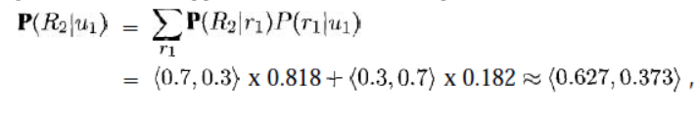

Example: Weather HMM
On day 1, the umbrella appears, so U = true, The prediction from t = 0 to t == 1 is
P(R₁) = ∑_{r0} P(R₁| r0 ) P(r0 )
and updating it with the evidence for t = 1 gives
On day 2, the umbrella appears, so U = true, The prediction from t = 1 to t == 2 is
and updating it with the evidence for t = 2 gives
Notes:
P (R1 | u1) = P(u1 | R1) P (R1) / P (u1)
Remove P (u1) for division to get approximation
a = show approximation
P (R1 | u1) = a P(u1 | R1) P (R1)
P (R1 | u1) = 0.45
P(u1) = 0.55
P (R1 | u1) = 0.45 / 1.1
Procedure:
Step 1: Compute Z = sum over all entries
Step 2: Divide every entry by Z

Slide 20
Example: Weather HMM
B’(+r) = 0.5
B’(-r) = 0.5
B’(+r) = 0.627
B’(-r) = 0.373
B(+r) = 0.5
B(-r) = 0.5
B(+r) = 0.818
B(-r) = 0.182
B(+r) = 0.883
B(-r) = 0.117
Transition Probabilities
Emission Probabilities
Rain₀
Rain₁
Rain₂
R_{t} | R_{t+1} | P(R_{t+1}|R_{t})
+r | +r | 0.7
+r | -r | 0.3
-r | +r | 0.3
-r | -r | 0.7
R_{t} | U_{t} | P(U_{t}|R_{t})
+r | +u | 0.9
+r | -u | 0.1
-r | +u | 0.2
-r | -u | 0.8
Umbrella₁
Umbrella₂
Notes:
demo

Slide 21




Example 2: Weather and Mode HMM
Example: Consider the example which elaborates how a person feels on different climates.
Notes:
demo

Slide 22
Example 2: Weather and Mode HMM
Example: Consider the example which elaborates how a person feels on different climates.
Sunny₀
Rain₁
Sunny₂
Happy₀
grumpy₁
Happy₂
Notes:
demo

Slide 23
Example 2: Weather and Mode HMM
Example: Consider the example which elaborates how a person feels on different climates.
Transition Probabilities
Transition Probabilities
8
0.8
S_{t} | S_{t+1} | P(S_{t+1}|S_{t})
sunny | sunny | 0.8
sunny | rainy | 0.2
rainy | rainy | 0.6
rainy | sunny | 0.4
2
0.2
2
0.4
3
0.6
Notes:
demo

Slide 24
Example 2: Weather and Mode HMM
Example: Consider the example which elaborates how a person feels on different climates.
Emission Probabilities
Emission Probabilities
8
0.8
S_{t} | H_{t} | P(H_{t}|S_{t})
sunny | happy | 0.8
sunny | grumpy | 0.2
rainy | happy | 0.4
rainy | grumpy | 0.6
2
0.2
2
0.4
3
0.6
Notes:
demo

Slide 25
Example 2: Weather and Mode HMM
Example: Consider the example which elaborates how a person feels on different climates.
Probability of sunny
Probability of rainy
5 / 15
0.33
10 / 15
0.67
Probability of happy
Probability of grumpy
10 / 15
0.67
5 / 15
0.33
Notes:
demo

Slide 26
Example 2: Weather and Mode HMM
If Happy today, what is probability its sunny or rainy?
S_{t} | H_{t} | P(H_{t}|S_{t})
sunny | happy | 0.8
sunny | grumpy | 0.2
rainy | happy | 0.4
rainy | grumpy | 0.6
P(Sunny|Happy) = P(Happy|Sunny) P(sunny) / P(Happy) => 0.8 * 0.67/ 0.67 => 0.8
P(rainy|Happy) = P(Happy|rainy) P(rainy)/ P(Happy) => 0.4 * 0.33 / 0.67 = 0.2
S_{t} | S_{t+1} | P(S_{t+1}|S_{t})
sunny | sunny | 0.8
sunny | rainy | 0.2
rainy | rainy | 0.6
rainy | sunny | 0.4
Notes:
a = show approximation
P(Sunny|Happy) = a P(Happy|Sunny) P(sunny)
= a 0.8 * 0.67 = 0.536
P (rainy | happy) = a P(Happy|rainy) P(rainy)
= a 0.4 * 0.33 = 0.132
So after approximation ~~ P(Sunny|Happy) = <0.546> = <0.8>

Slide 27
Example 2: Weather and Mode HMM
If Happy-grumpy, what is weather for 2 days?
P(Sunny, Rainy) = P(Sunny) P(Happy | Sunny) P (Rainy | Sunny) P(grumpy | Rainy)
P(Sunny, Rainy) = 0.67 * 0.8 * 0.2 * 0.6 => 0.064
P(Sunny, Sunny) = P(Sunny) P(Happy | Sunny) P (Sunny | Sunny) P(grumpy | Sunny)
P(Sunny, Rainy) = 0.67 * 0.8 * 0.8 * 0.2 => 0.085
P(Rainy, Sunny) = P(Rainy) P(Happy | Rainy) P (Rainy | Sunny) P(grumpy | Sunny)
P(Rainy, Sunny) = 0.33 * 0.4 * 0.4 * 0.2 => 0.010
S_{t} | H_{t} | P(H_{t}|S_{t})
sunny | happy | 0.8
sunny | grumpy | 0.2
rainy | happy | 0.4
rainy | grumpy | 0.6
S_{t} | S_{t+1} | P(S_{t+1}|S_{t})
sunny | sunny | 0.8
sunny | rainy | 0.2
rainy | rainy | 0.6
rainy | sunny | 0.4
Notes:
demo

Slide 28
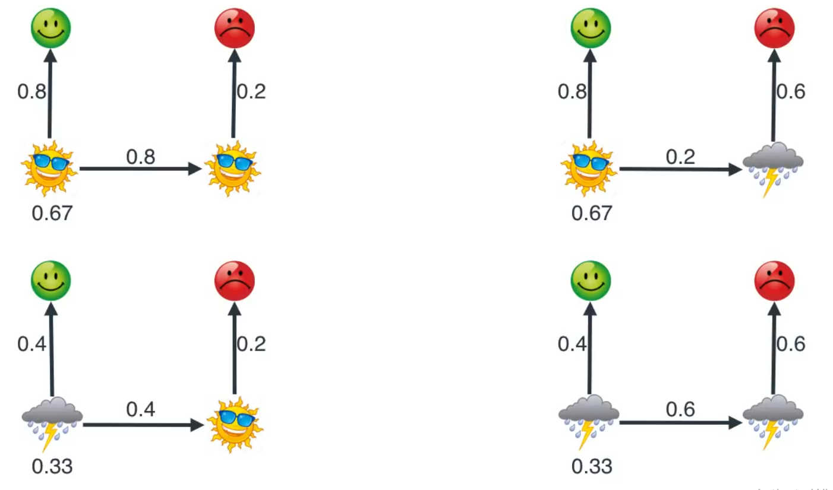
Example 2: Weather and Mode HMM
Notes:
demo

Slide 29
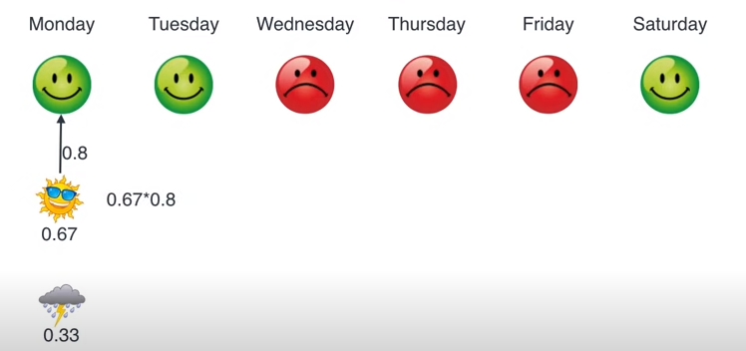

Slide 30
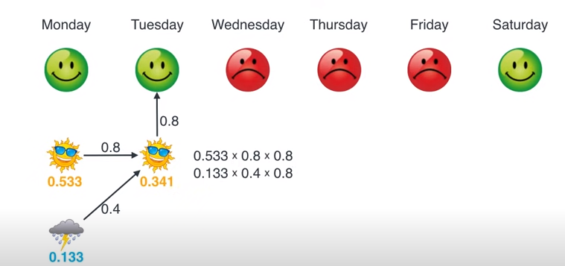

Slide 31
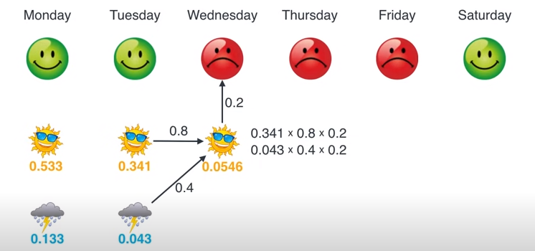

Slide 32
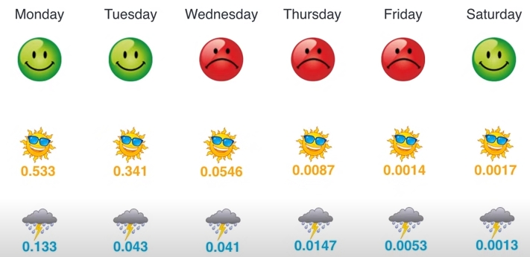

Slide 33
